Slide 2

Ypp 4
bbv Software Services AG | 2025

Slide 3




Presentation on Microsoft Lists
bbv Software Services AG | 2025

Slide 4
Agenda
Introduction
Key Functionalities
Q&A

Slide 5

Introduction
What is Microsoft Lists?

Slide 6
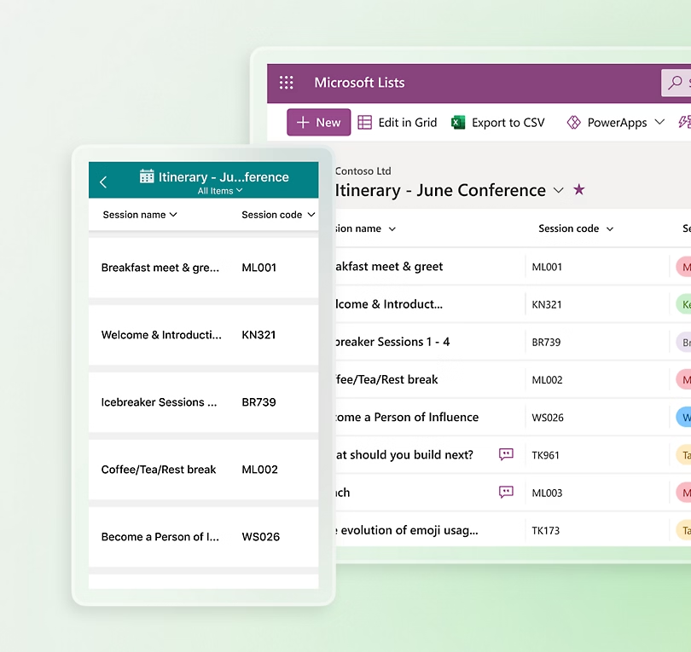
Introduction
MS List is a tool for managing structured lists of data
Works like a simple table or database
Let’s users:
Create lists
View data
Manage info clearly and easily

Slide 7

Key Functionalities

Slide 8
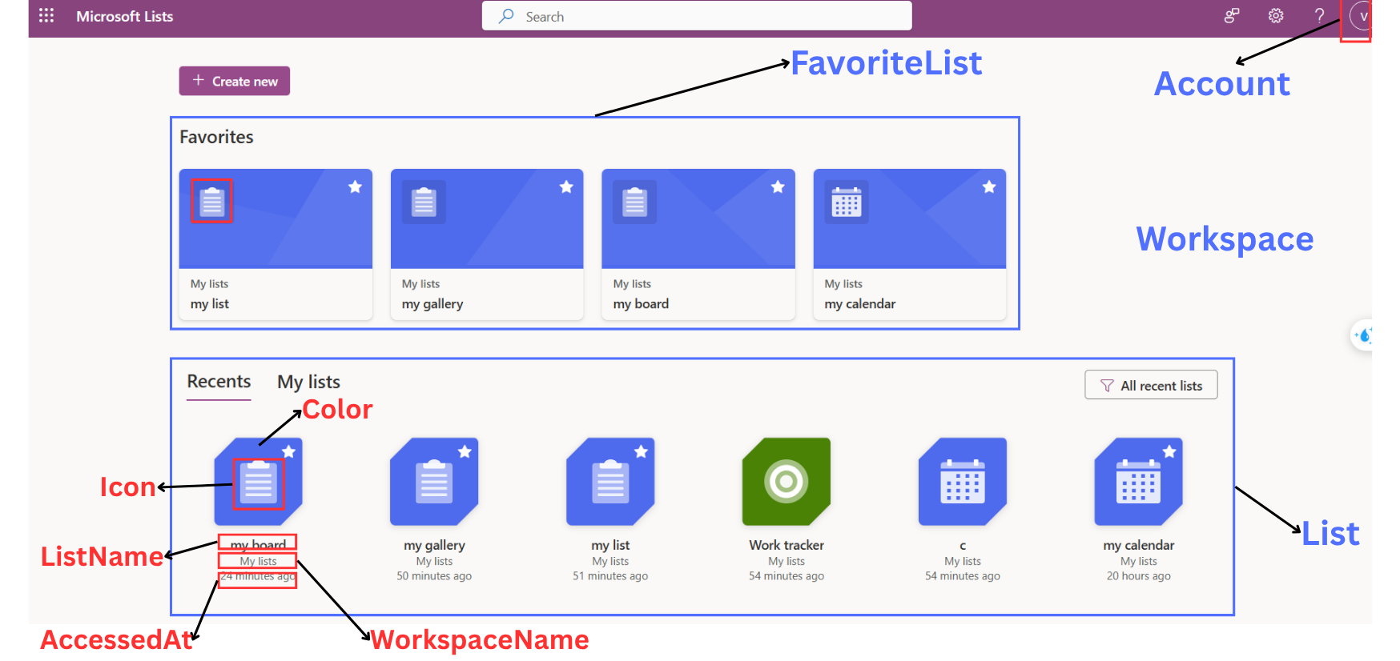
Dashboard
Notes:
-- screen 1: dashboard & account
-- case 1: favorites list from user
DECLARE @AccountId INT = 1;
SELECT
l.Id AS ListId,
l.Icon,
l.Color,
w.WorkspaceName,
l.ListName
FROM
List l
JOIN FavoriteList fl ON fl.Id = l.Id
JOIN Account a ON a.Id = fl.ListId
JOIN Workspace w ON w.Id = l.WorkspaceId
WHERE
a.Id = @AccountId
GO
-- case 2: find recents list
DECLARE @AccountId INT = 1;
SELECT
l.Id AS ListId,
l.Color,
l.Icon,
l.ListName,
w.WorkspaceName,
l.AccessedAt
FROM
List l
JOIN AccountList al ON al.ListId = l.Id
JOIN Account a ON a.Id = al.AccountId
JOIN Workspace w ON w.Id = l.WorkspaceId
WHERE
a.Id = @AccountId
ORDER BY
l.AccessedAt DESC
GO
-- case 3: find all list from user
DECLARE @AccountId INT = 1;
SELECT
l.Id AS ListId,
l.Color,
l.Icon,
l.ListName,
w.WorkspaceName
FROM
List l
JOIN AccountList al ON al.ListId = l.Id
JOIN Account a ON a.Id = al.AccountId
JOIN Workspace w ON w.Id = l.WorkspaceId
WHERE
a.Id = @AccountId
ORDER BY
l.CreatedAt DESC
GO -- case 5: search list (apply paging for query)
DECLARE @Query NVARCHAR(100) = 't'
DECLARE @PageSize INT = 24;
DECLARE @PageNumber INT = 1;
SELECT
l.Id AS ListId,
l.Icon,
l.Color,
l.ListName,
w.WorkspaceName
FROM
List l
JOIN Workspace w ON w.Id = l.WorkspaceId
WHERE
ListName LIKE '%' + @Query + '%'
ORDER BY
ListName
OFFSET (@PageNumber - 1) * @PageSize ROWS
FETCH NEXT @PageSize ROWS ONLY;
GO

Slide 9
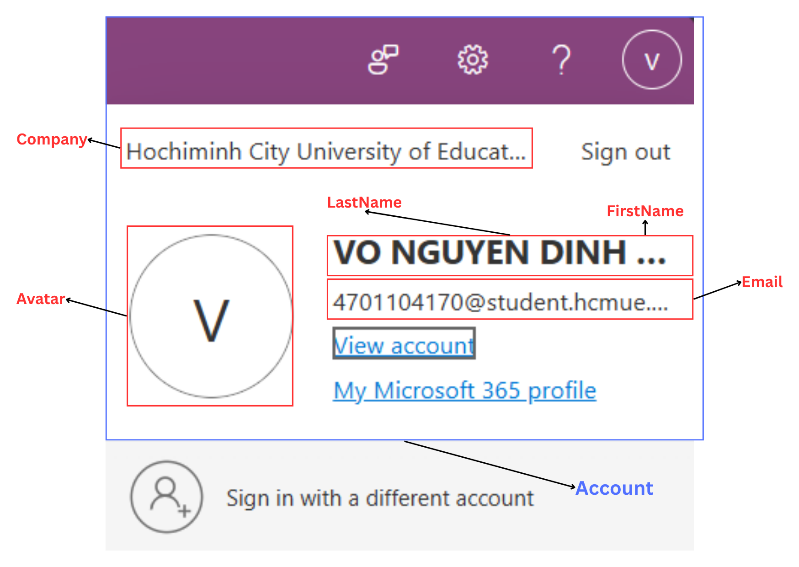
Account
Notes:
-- case 4: find Account by Id
DECLARE @AccountId INT = 1;
SELECT
a.LastName + ' ' + a.FirstName AS FullName,
a.Email,
a.Avatar,
a.Company
FROM
Account a
WHERE
a.Id = @AccountId
GO

Slide 10
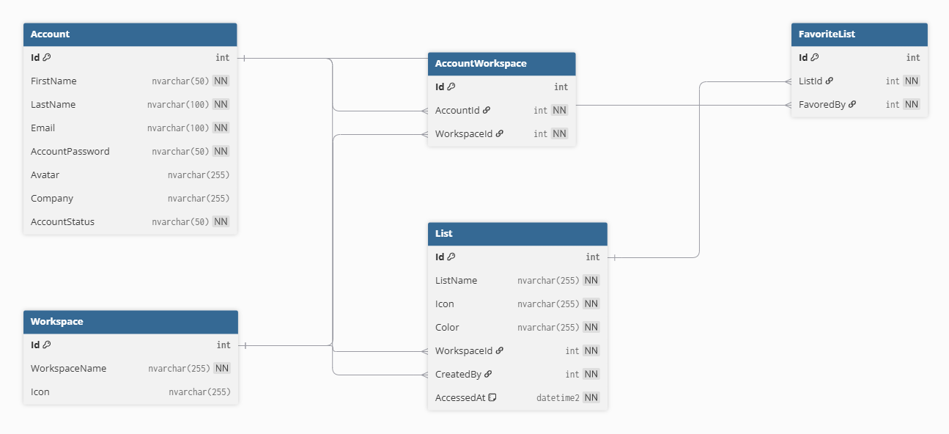
Dashboard Entities

Slide 11
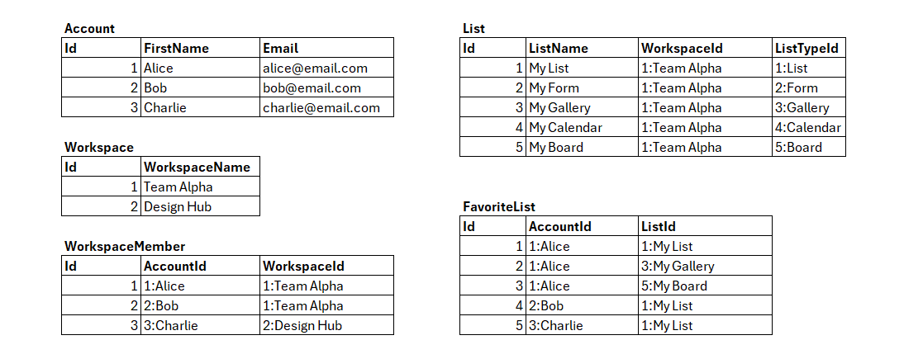
Sample data for Dashboard

Slide 12
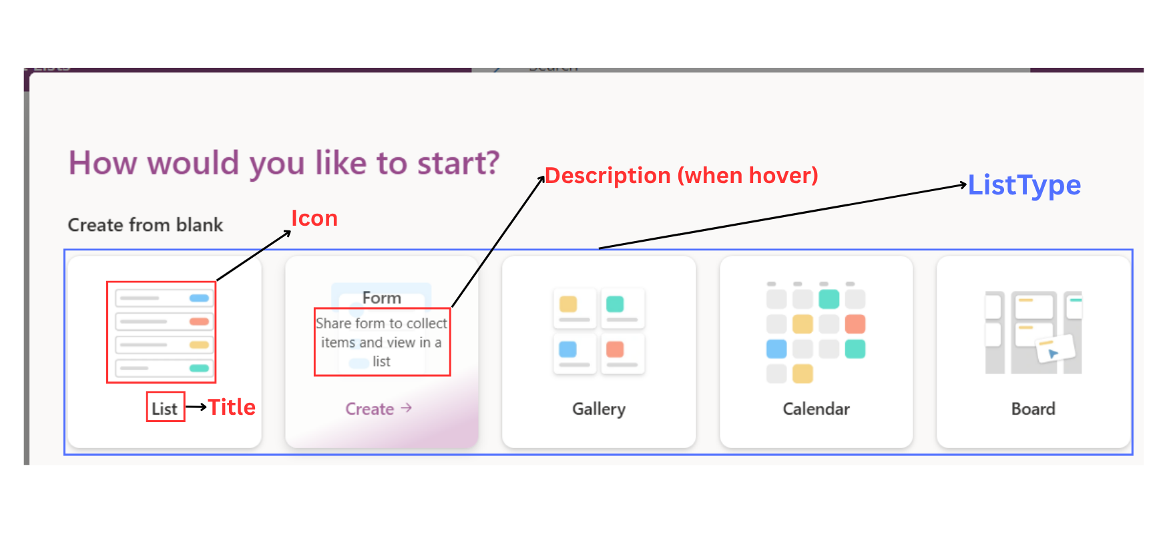
List Type
Notes:
-- screen 2: create list screen (when user choose create new)
-- case 1: show list type
SELECT
lt.Id AS ListTypeId,
lt.Icon,
lt.Title,
lt.ListTypeDescription
FROM
ListType lt
GO

Slide 13
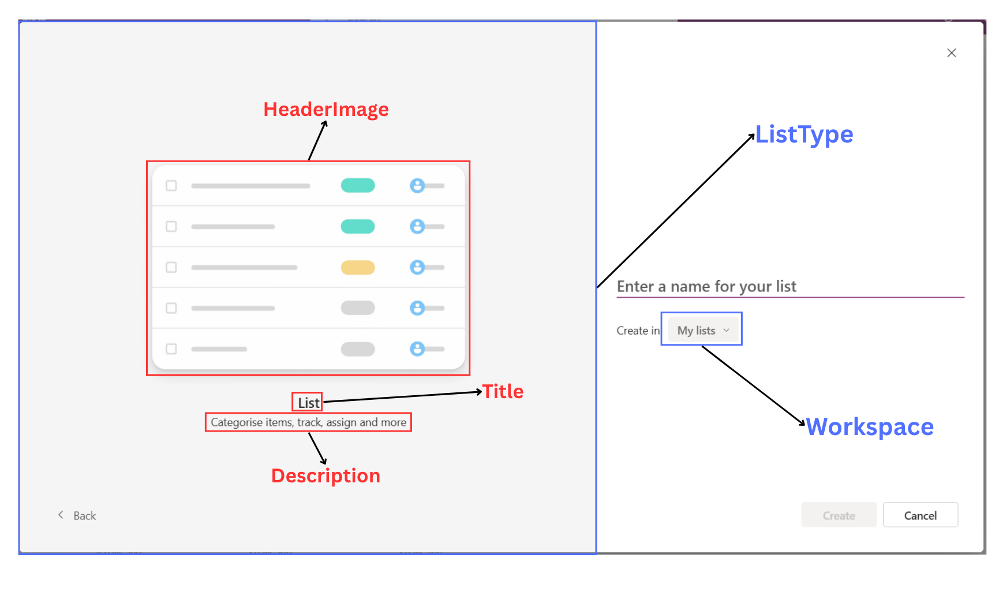
List Type
Notes:
DECLARE @ListTypeId INT = 1;
SELECT
Id AS ListTypeId,
Title,
ListTypeDescription,
HeaderImage
FROM
ListType
WHERE
Id = @ListTypeId
GO
-- case 2: show all workspace by account id
DECLARE @AccountId INT = 1;
SELECT
w.Id AS WorkspaceId,
w.WorkspaceName,
w.Icon
FROM
Workspace w
JOIN AccountWorkspace wb ON wb.WorkspaceId = w.Id
JOIN Account a ON a.Id = wb.AccountId
WHERE
a.Id = @AccountId
GO

Slide 14
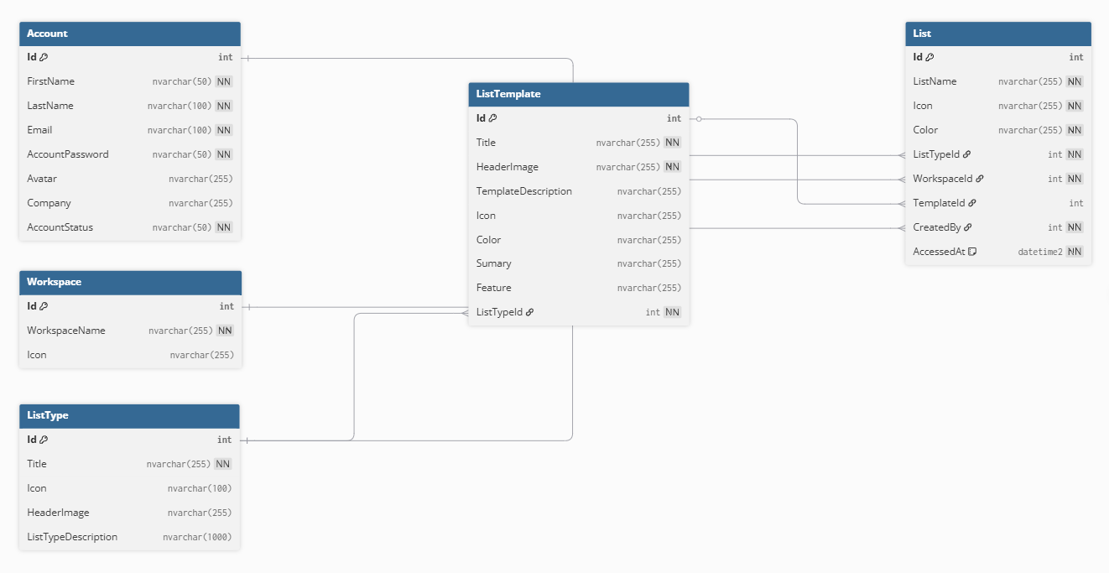
Create List Entities

Slide 15
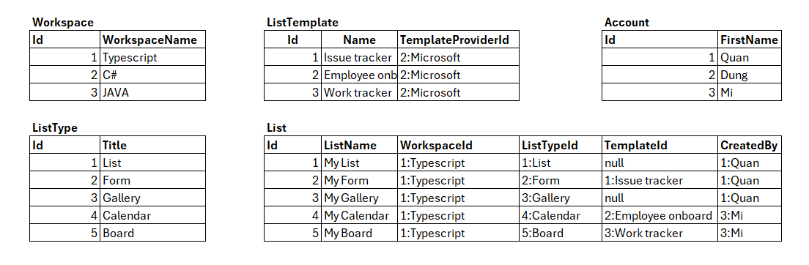
Sample data for Create List

Slide 16
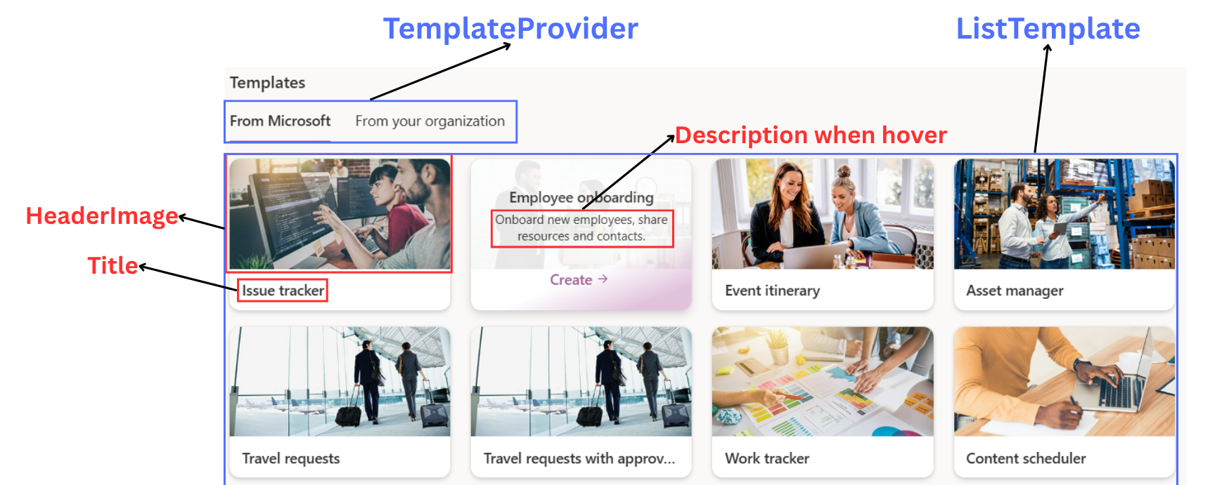
List Template
Notes:
-- case 2: show template from Microsoft
DECLARE @ProviderId INT = 1;
SELECT
lt.Id AS ListTemplateId,
lt.HeaderImage,
lt.Title,
lt.TemplateDescription
FROM
ListTemplate lt
JOIN TemplateProvider tp ON tp.Id = lt.TemplateProviderId
WHERE
tp.Id = @ProviderId
GO
-- check cache for list template
SELECT
cp.usecounts, -- Number of times the execution plan has been reused
cp.cacheobjtype, -- Type of cached object (e.g., Compiled Plan, Execution Context)
cp.objtype, -- Type of statement (Adhoc, Prepared, Proc, etc.)
st.text AS QueryText -- The actual SQL query text
FROM sys.dm_exec_cached_plans AS cp
CROSS APPLY sys.dm_exec_sql_text(cp.plan_handle) AS st
WHERE st.text LIKE '%ListTemplate%' -- Filter queries related to the ListTemplate table
ORDER BY cp.usecounts DESC; -- Sort by reuse count in descending order

Slide 17
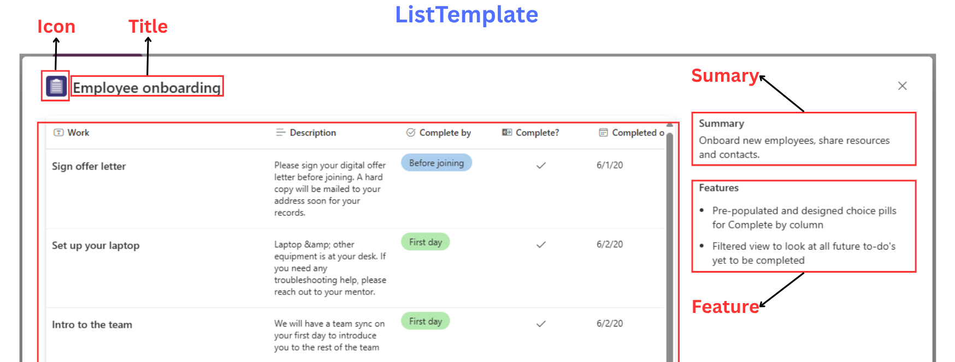
List Template
Notes:
-- screen 4: when user choose template
-- case 1: find list template by id
DECLARE @ListTemplateId INT = 1;
SELECT
lt.Id,
lt.Icon,
lt.Title,
lt.Sumary,
lt.Feature
FROM
ListTemplate lt
WHERE
lt.Id = @ListTemplateId
GO

Slide 18
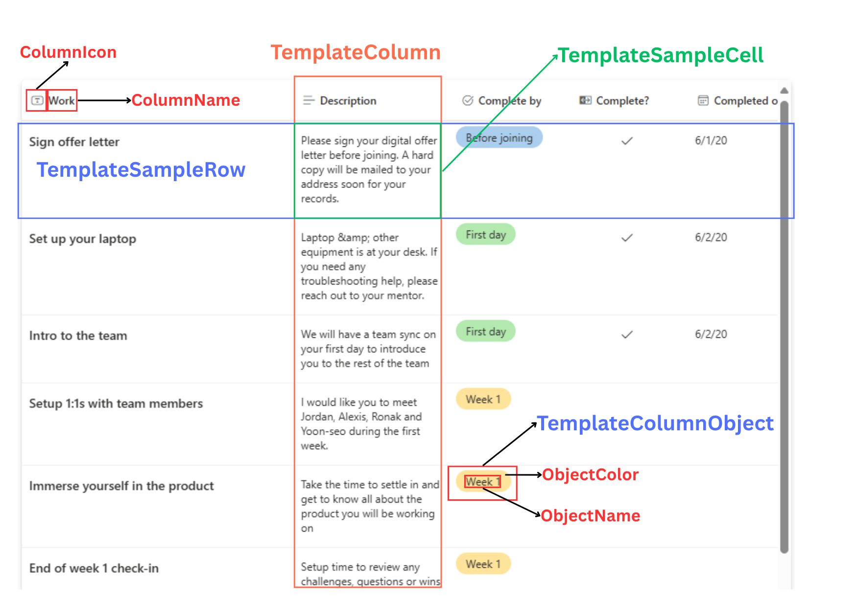
List Template
Notes:
-- case 4: get all data of list
DECLARE @ListTemplateId INT = 1;
DECLARE @cols NVARCHAR(MAX),
@sql NVARCHAR(MAX);
-- 1. Get dynamic column list
SELECT
@cols = STRING_AGG(QUOTENAME(tc.Id), ',')
FROM
TemplateColumn tc
WHERE
tc.ListTemplateId = @ListTemplateId;
-- 2. Build dynamic SQL with PIVOT
SET
@sql = '
SELECT *
FROM (
SELECT
tsr.Id AS TemplateSampleRowId,
tc.Id AS TemplateColumnId,
tscv.CellValue
FROM TemplateSampleRow tsr
CROSS JOIN TemplateColumn tc
LEFT JOIN TemplateSampleCellValue tscv
ON tscv.TemplateSampleRowId = tsr.Id
AND tscv.TemplateColumnId = tc.Id
WHERE tsr.ListTemplateId = ' + CAST(@ListTemplateId AS NVARCHAR) + '
AND tc.ListTemplateId = ' + CAST(@ListTemplateId AS NVARCHAR) + '
) AS SourceTable
PIVOT (
MAX(CellValue)
FOR TemplateColumnId IN (' + @cols + ')
) AS PivotTable
ORDER BY TemplateSampleRowId;
';
-- 3. Execute dynamic SQL
EXEC sp_executesql @sql;
GO

Slide 19
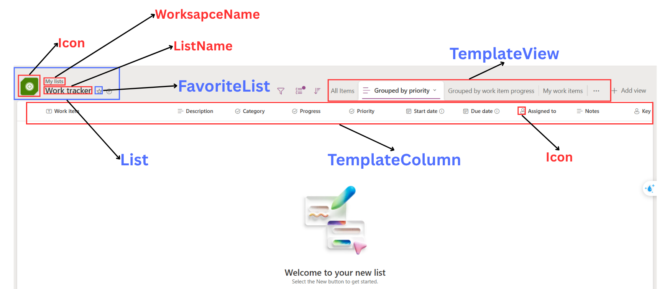
List By Template
Notes:
DECLARE @ListTemplateId INT = 1;
SELECT
tc.Id AS TempalteColumn,
sdt.Icon,
tc.ColumnName
FROM
TemplateColumn tc
JOIN SystemDataType sdt ON sdt.Id = tc.SystemDataTypeId
WHERE
tc.ListTemplateId = 1
ORDER BY
tc.DisplayOrder
GO
-- case 4: show all view in list template
DECLARE @ListTemplateId INT = 1;
SELECT
tv.Id AS TempalteViewId,
vt.Icon,
tv.ViewName
FROM
TemplateView tv
JOIN ViewType vt ON vt.Id = tv.ViewTypeId
WHERE
tv.ListTemplateId = 1
ORDER BY
tv.DisplayOrder
GO

Slide 20
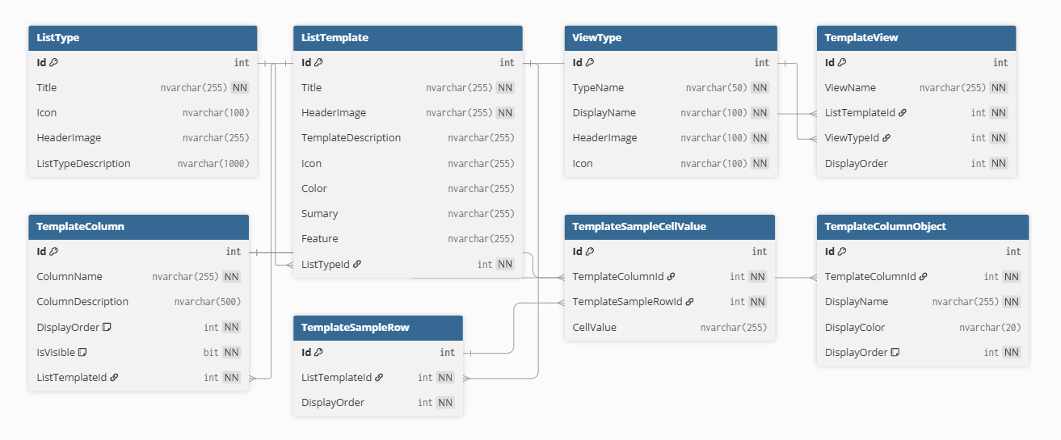
List Template Entities

Slide 21
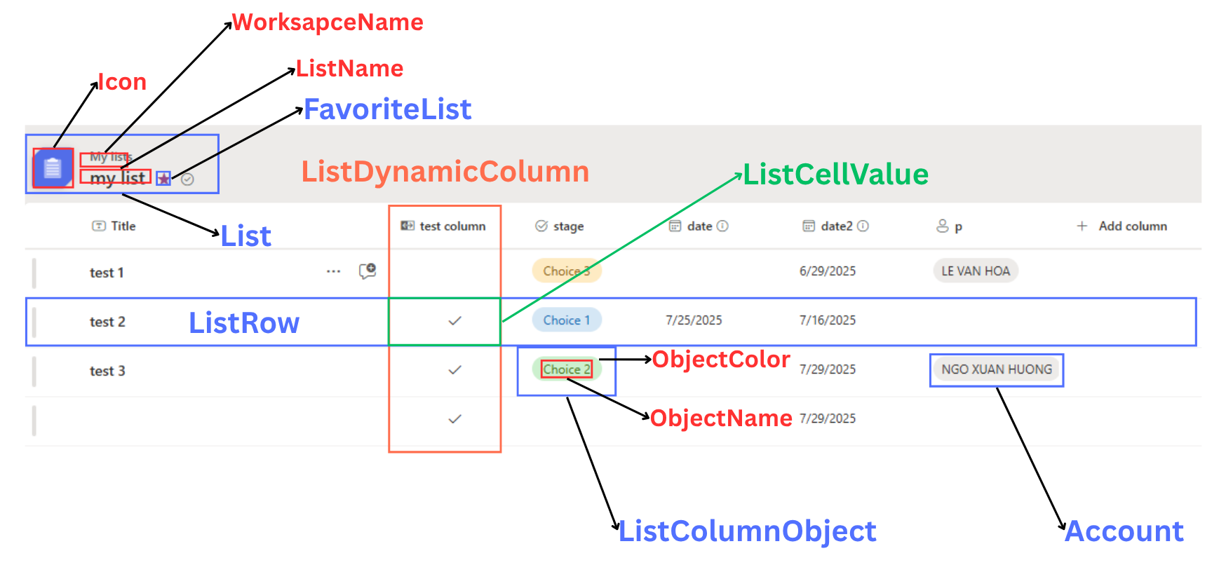
List
Notes:
-- screen 5: list (after user create list)
-- case 1: show info list
DECLARE @ListId INT = 1;
DECLARE @AccountId INT = 1;
SELECT
l.Id AS ListId,
l.Icon,
l.Color,
w.WorkspaceName,
l.ListName,
CASE
WHEN fl.Id IS NOT NULL THEN 1
ELSE 0
END AS IsFavoriteList
FROM
List l
JOIN Workspace w ON w.Id = l.WorkspaceId
LEFT JOIN FavoriteList fl ON fl.ListId = l.Id
AND fl.FavoredBy = @AccountId
WHERE
l.Id = @ListId
GO
-- case 2: show list column is visible
DECLARE @ListId INT = 1;
SELECT
ldc.Id AS ListColumnId,
sdt.Icon,
ldc.ColumnName,
sdt.DataTypeValue
FROM
ListDynamicColumn ldc
JOIN List l ON l.Id = ldc.ListId
JOIN SystemDataType sdt ON sdt.Id = ldc.SystemDataTypeId
WHERE
l.Id = @ListId
AND ldc.IsVisible = 1
ORDER BY
ldc.DisplayOrder
GO
-- case 3: show list data
DECLARE @ListId INT = 1;
DECLARE @cols NVARCHAR(MAX),
@sql NVARCHAR(MAX);
-- 1. get dynamic column
SELECT
@cols = STRING_AGG(QUOTENAME(ldc.Id), ',')
FROM
ListDynamicColumn ldc
WHERE
ldc.ListId = @ListId;
-- 2. build dynamic SQL with PIVOT
SET @sql = '
SELECT *
FROM (
SELECT
lr.Id AS ListRowId,
ldc.Id AS ListColumnId,
lcv.CellValue
FROM ListRow lr
CROSS JOIN ListDynamicColumn ldc
LEFT JOIN ListCellValue lcv
ON lcv.ListRowId = lr.Id
AND lcv.ListDynamicColumnId = ldc.Id
WHERE lr.ListId = ' + CAST(@ListId AS NVARCHAR) + '
AND ldc.ListId = ' + CAST(@ListId AS NVARCHAR) + '
) AS SourceTable
PIVOT (
MAX(CellValue)
FOR ListColumnId IN (' + @cols + ')
) AS PivotTable
ORDER BY ListRowId;
';
-- 3. execute dynamic SQL
EXEC sp_executesql @sql;
GO
-- case 4: show list view
DECLARE @ListId INT = 1;
SELECT
lv.Id AS ListViewId,
lv.ViewName
FROM
ListView lv
JOIN List l ON l.Id = lv.ListId
WHERE
l.Id = @ListId
GO

Slide 22
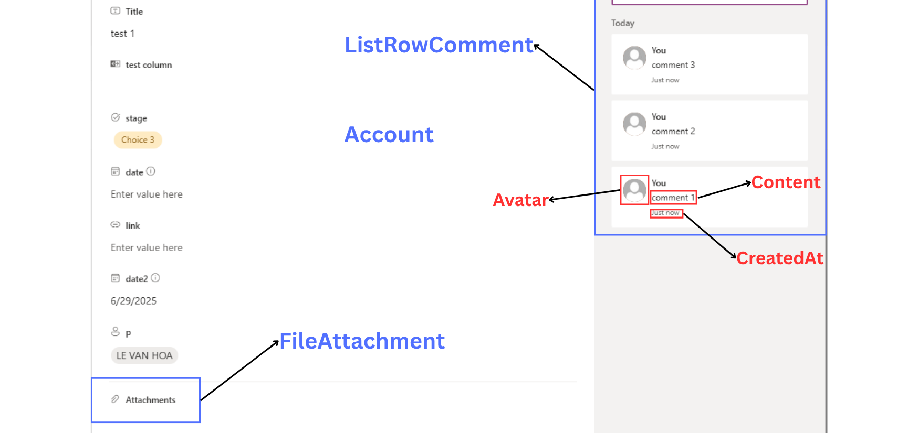
List Row Detail
Notes:
-- screen 7: List row detail
-- case 1: show row detail
DECLARE @ListRowId INT = 1;
SELECT
lr.Id AS ListRowId,
sdt.Icon,
ldc.ColumnName,
lcv.CellValue
FROM
List l
JOIN ListDynamicColumn ldc ON ldc.ListId = l.Id
JOIN ListRow lr ON lr.ListId = l.Id
LEFT JOIN ListCellValue lcv ON lcv.ListRowId = lr.Id
AND lcv.ListDynamicColumnId = ldc.Id
JOIN SystemDataType sdt ON sdt.Id = ldc.SystemDataTypeId
WHERE
lr.Id = @ListRowId
GO
-- case 2: show row file attachment
DECLARE @ListRowId INT = 1;
SELECT
fa.Id AS FileAttachmentId,
fa.NameFile,
fa.FileUrl
FROM
ListRow lr
JOIN FileAttachment fa ON fa.ListRowId = lr.Id
WHERE
lr.Id = @ListRowId
GO
-- case 3: show all comments by row
DECLARE @ListRowId INT = 1;
SELECT
lrc.Id AS CommentId,
a.FirstName,
a.LastName,
a.Avatar,
lrc.Content,
lrc.CreatedAt
FROM
ListRowComment lrc
JOIN ListRow lr ON lr.Id = lrc.ListRowId
JOIN Account a ON a.Id = lrc.CreatedBy
WHERE
lr.Id = @ListRowId
ORDER BY
lrc.CreatedAt DESC
GO

Slide 23
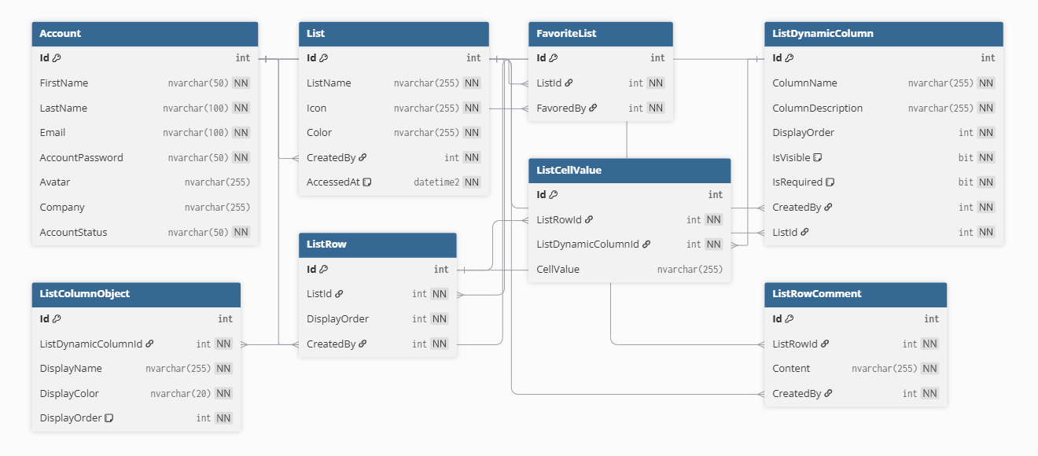
List Entities

Slide 24
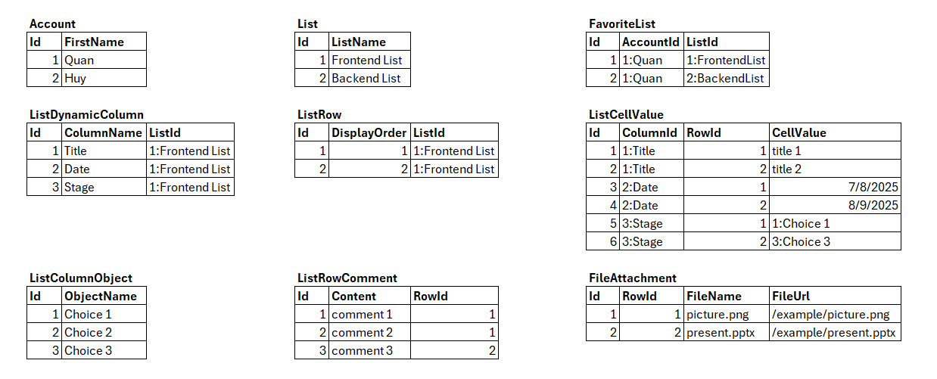
Sample Data for List

Slide 25
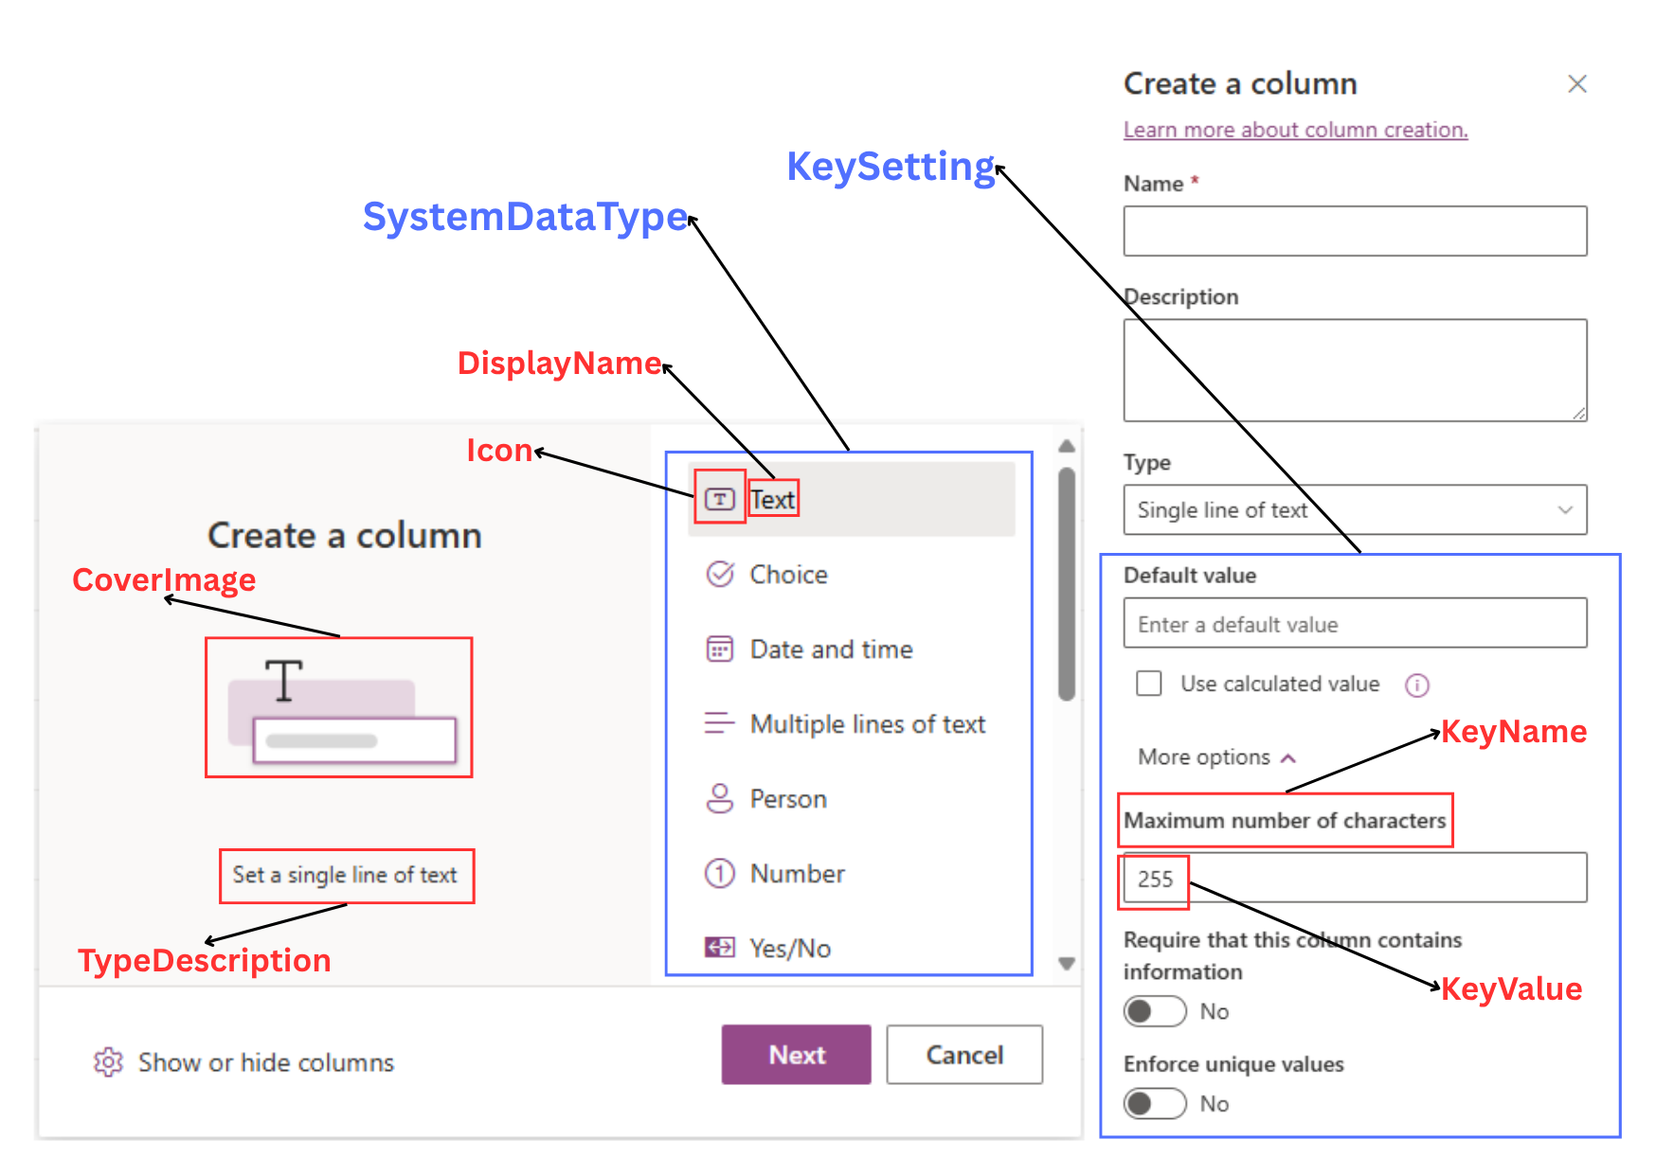
List Dynamic Column
Notes:
-- screen 8: Custom column
-- case 1: find all column type
SELECT
sdt.Id AS SystemDataTypeId,
sdt.Icon,
sdt.DisplayName,
sdt.CoverImage,
sdt.TypeDescription
FROM
SystemDataType sdt
GO
-- case 2: when user choose column type
DECLARE @SystemDataTypeId INT = 1;
SELECT
sdt.Id AS SystemDataTypeId,
sdt.DisplayName,
sdt.DataTypeValue,
ks.KeyName,
ks.DisplayName,
ks.ValueType
FROM
DataTypeSettingKey dtsk
JOIN SystemDataType sdt ON sdt.Id = dtsk.SystemDataTypeId
JOIN KeySetting ks ON ks.Id = dtsk.KeySettingId
WHERE
sdt.Id = @SystemDataTypeId
GO
-- case 3: when user choose edit column (column value)
DECLARE @ListColumnId INT = 1;
SELECT
ldc.Id AS ListColumnId,
ldc.ColumnName,
ldc.ColumnDescription,
sdt.Id AS SystemDataTypeId,
sdt.DisplayName,
sdt.DataTypeValue
FROM
ListDynamicColumn ldc
JOIN SystemDataType sdt ON sdt.Id = ldc.SystemDataTypeId
WHERE
ldc.Id = @ListColumnId
GO
-- case 4: when user choose edit column (column setting)
DECLARE @ListColumnId INT = 1;
SELECT
dtsk.Id AS DataTypeSettingKeyId,
ks.KeyName,
ks.DisplayName,
ks.ValueType,
lcsv.Id AS SettingValueId
FROM
ListDynamicColumn ldc
JOIN SystemDataType sdt ON sdt.Id = ldc.SystemDataTypeId
JOIN DataTypeSettingKey dtsk ON dtsk.SystemDataTypeId = sdt.Id
JOIN KeySetting ks ON ks.Id = dtsk.KeySettingId
LEFT JOIN ListColumnSettingValue lcsv ON lcsv.ColumnId = ldc.Id
AND lcsv.DataTypeSettingKeyId = dtsk.Id
WHERE
ldc.Id = @ListColumnId
GO

Slide 26
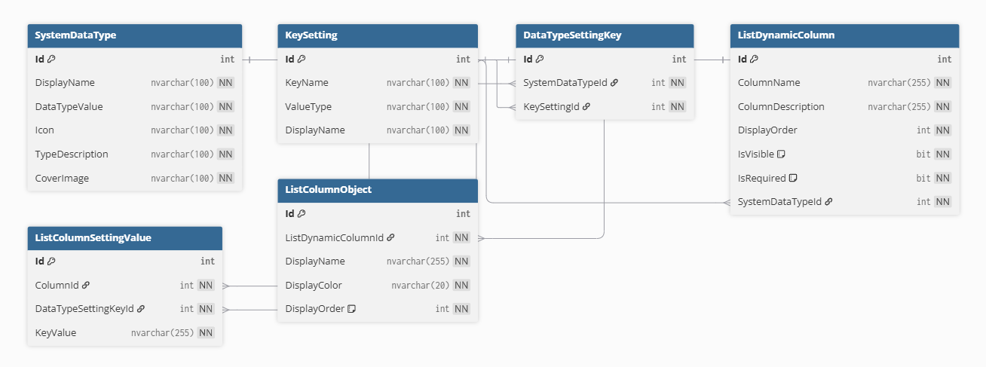
List Dynamic Column Entities

Slide 27
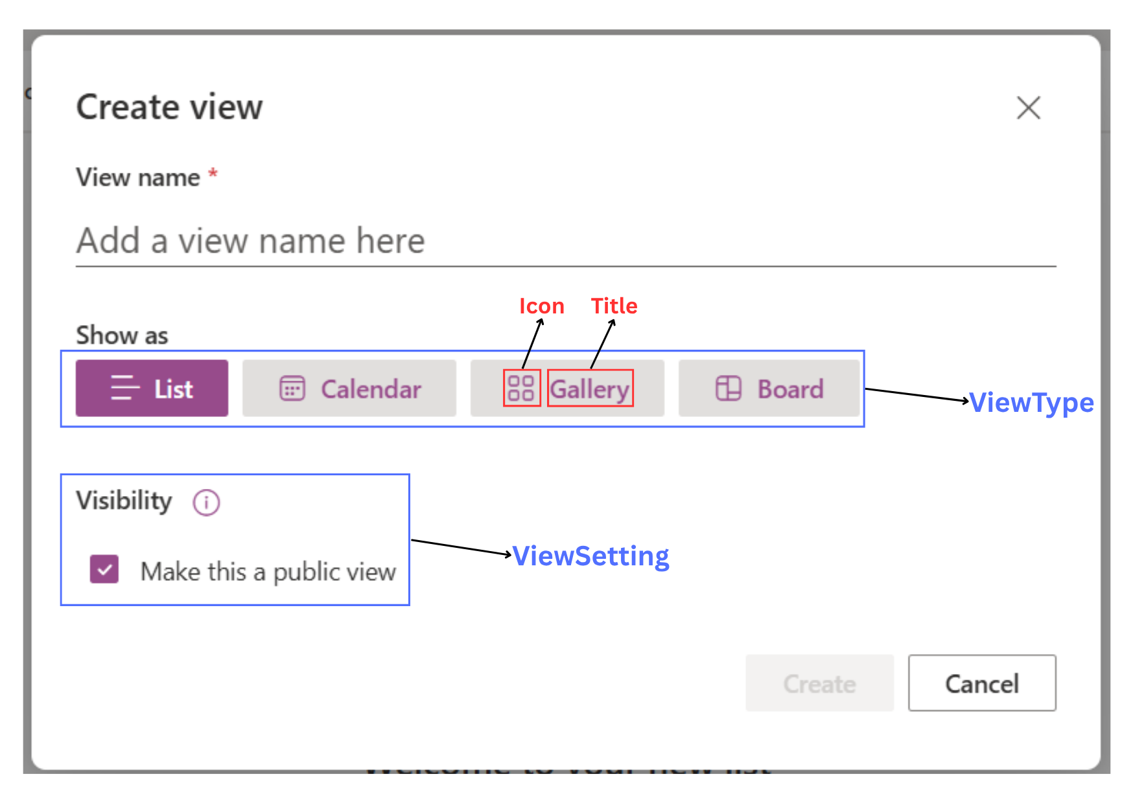
View Type Setting
Notes:
-- screen 9: create view for list
-- case 1: create view with calendar type
DECLARE @ViewTypeId INT = 2;
SELECT
vt.Id AS ViewTypeId,
vt.Icon,
vt.TypeName,
vs.DisplayName,
vs.ValueType
FROM
ViewTypeSetting vts
JOIN ViewType vt ON vt.Id = vts.ViewTypeId
JOIN ViewSetting vs ON vs.Id = vts.ViewSettingId
WHERE
vt.Id = @ViewTypeId
GO
-- case 2: ref column have type DATE for Calendar View
DECLARE @ListId INT = 299;
SELECT
ldc.Id AS ListColumnId,
ldc.ColumnName
FROM
ListDynamicColumn ldc
JOIN SystemDataType sdt ON sdt.Id = ldc.SystemDataTypeId
JOIN List l ON l.Id = ldc.ListId
WHERE
sdt.DataTypeValue = 'DATE'
AND l.Id = @ListId
GO
-- case 3: ref title & subheading column for Calendar View
DECLARE @ListId INT = 2;
SELECT
ldc.Id AS ListColumnId,
ldc.ColumnName
FROM
ListDynamicColumn ldc
JOIN SystemDataType sdt ON sdt.Id = ldc.SystemDataTypeId
JOIN List l ON l.Id = ldc.ListId
WHERE
l.Id = @ListId
GO

Slide 28
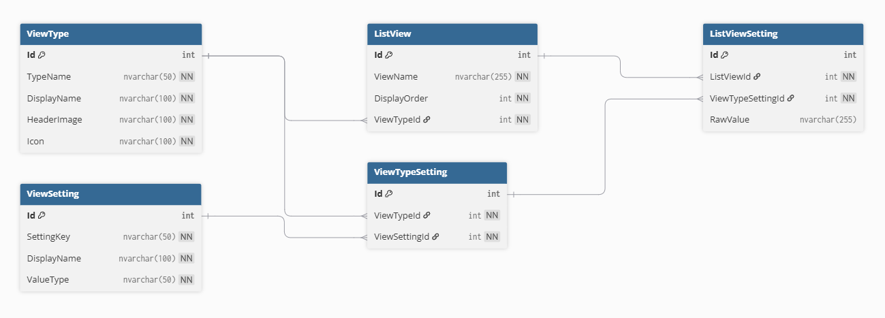
List View Entities

Slide 29
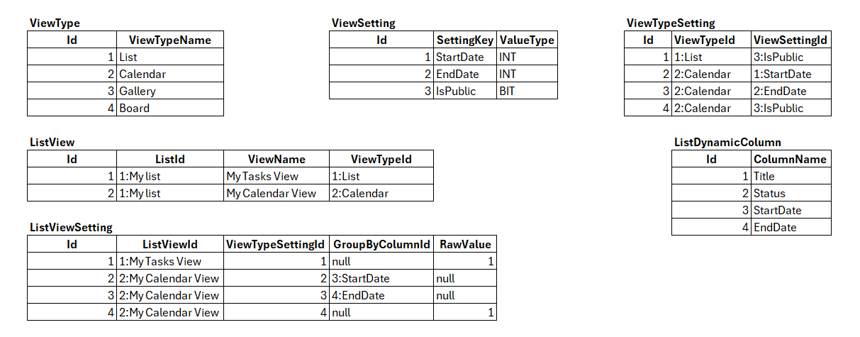
Sample data for List View

Slide 30
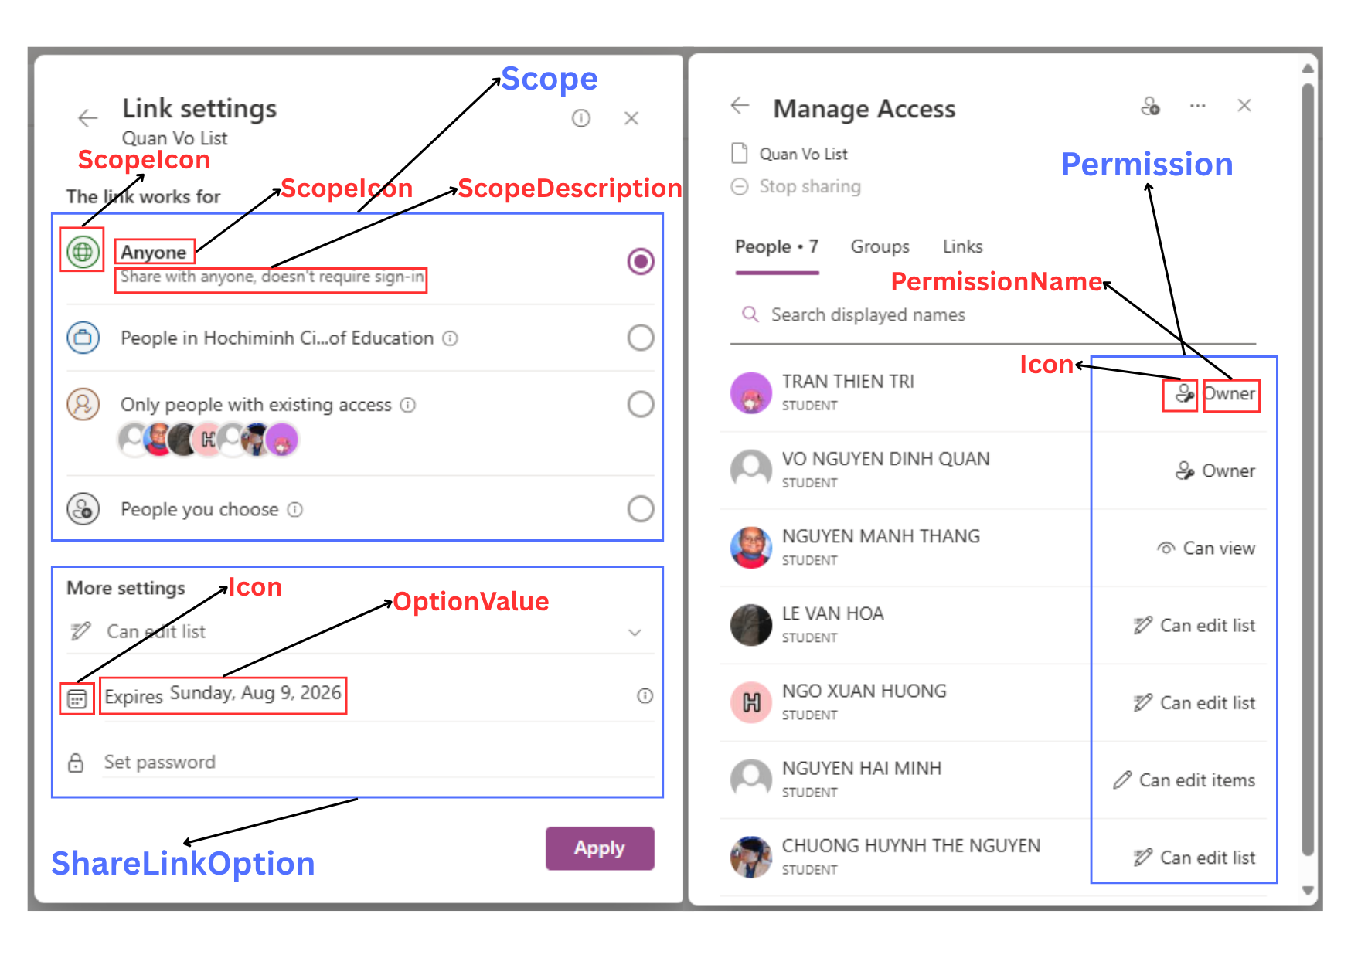
Share Link
Notes:
-- screen 10: share link
-- case 1: show curent list name
DECLARE @ListId INT = 1;
SELECT
Id AS ListId,
ListName
FROM
List
WHERE
Id = @ListId
GO
-- case 2: show all scope
SELECT
Id AS ScopeId,
ScopeIcon,
ScopeName,
ScopeDescription,
ScopeCode
FROM
Scope
GO
-- case 3: show all permission
SELECT
Id AS PermissionId,
PermissionIcon,
PermissionName,
PermissionDescription,
PermissionCode
FROM
Permission
GO
-- case 4: show option if user choose scope 'PUBLIC'
DECLARE @ScopeCode NVARCHAR(50) = 'PUBLIC';
SELECT
s.Id AS ScopeId,
s.ScopeIcon,
s.ScopeName,
s.ScopeDescription
FROM
ShareLinkOption slo
JOIN Scope s ON s.Id = slo.ScopeId
WHERE
s.ScopeCode = @ScopeCode
GO
-- case 5: show option if user choose scope 'SPECIFIC'
DECLARE @ScopeCode NVARCHAR(50) = 'SPECIFIC';
SELECT
s.Id AS ScopeId,
s.ScopeIcon,
s.ScopeName,
s.ScopeDescription
FROM
ShareLinkOption slo
JOIN Scope s ON s.Id = slo.ScopeId
WHERE
s.ScopeCode = @ScopeCode
GO
-- screen 11: manage access
-- case 1: count people have permission
DECLARE @ListId INT = 14;
SELECT
COUNT(*) AS People
FROM
ListMemberPermission lmp
JOIN List l ON l.Id = lmp.ListId
JOIN Permission p ON p.Id = lmp.HighestPermissionId
JOIN Account a ON a.Id = lmp.AccountId
WHERE
l.Id = @ListId
GO
-- case 2: show info all user have permission in list
DECLARE @ListId INT = 1;
SELECT
l.Id AS ListId,
l.ListName,
a.Id AS AccountId,
a.Avatar,
a.FirstName,
a.LastName,
a.Email,
p.Id AS PermissionId,
p.PermissionIcon,
p.PermissionName
FROM
ListMemberPermission lmp
JOIN List l ON l.Id = lmp.ListId
JOIN Permission p ON p.Id = lmp.HighestPermissionId
JOIN Account a ON a.Id = lmp.AccountId
WHERE
l.Id = @ListId
GO

Slide 31
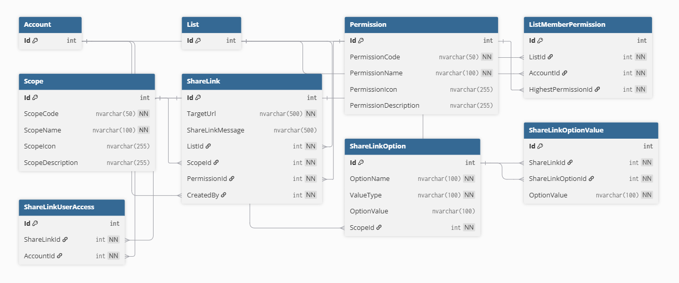
Manage Access Entities

Slide 32
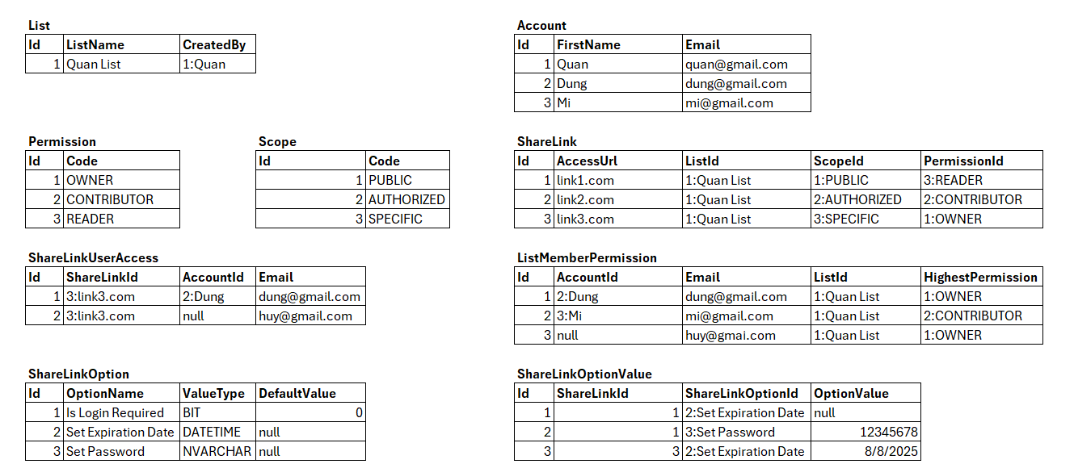
Sample data for Manage Access

Slide 33
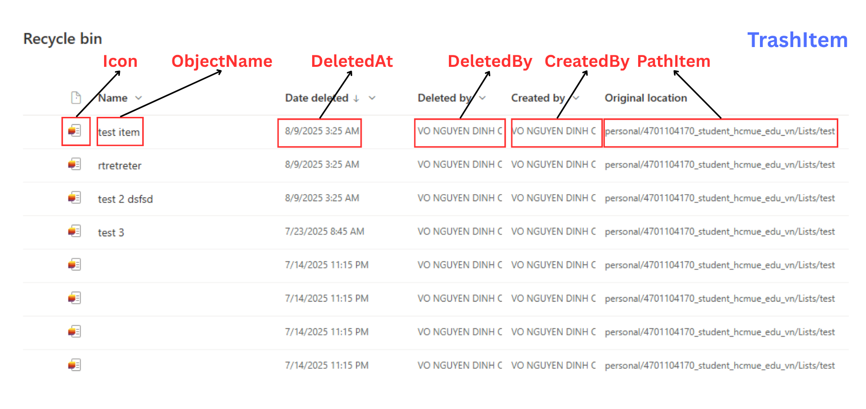
Trash Item
Notes:
-- screen 12: trash items
-- case 1: default
SELECT
ti.Id AS TrashItemId,
ot.ObjectName,
FORMAT(ti.DeleteAt, 'M/d/yyyy h:mm tt') AS DateDeleted,
deleter.FirstName + ' ' + deleter.LastName AS DeletedBy,
creator.FirstName + ' ' + creator.LastName AS CreatedBy,
ti.PathItem AS OriginalLocation
FROM
TrashItem ti
JOIN Account creator ON creator.Id = ti.CreateBy
JOIN Account deleter ON deleter.Id = ti.DeletedBy
JOIN ObjectType ot ON ot.Id = ti.ObjectTypeId
GO
-- case 2: sort A-Z ObjectName
SELECT
ti.Id AS TrashItemId,
ot.ObjectName,
FORMAT(ti.DeleteAt, 'M/d/yyyy h:mm tt') AS DateDeleted,
deleter.FirstName + ' ' + deleter.LastName AS DeletedBy,
creator.FirstName + ' ' + creator.LastName AS CreatedBy,
ti.PathItem AS OriginalLocation
FROM
TrashItem ti
JOIN Account creator ON creator.Id = ti.CreateBy
JOIN Account deleter ON deleter.Id = ti.DeletedBy
JOIN ObjectType ot ON ot.Id = ti.ObjectTypeId
ORDER BY
ot.ObjectName ASC
GO

Slide 34
Q&A

Slide 36
bbv template EN
How-to guides

Slide 37
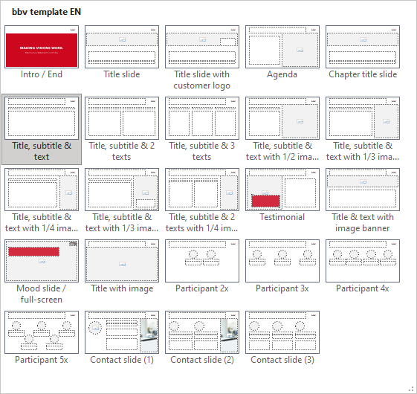
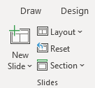

bbv Master layouts & slide library
Insert new slide
1
Click on «New Slide»
1
2
Select layout
Choose the desired layout from the pre-programmed master layouts.
2
→
Or select layout from slide library

Slide 38
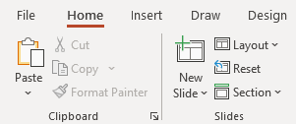
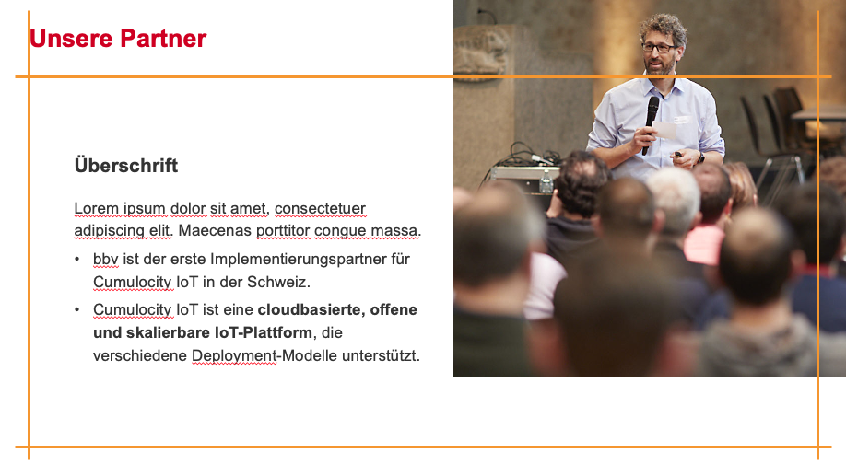
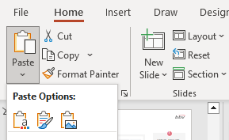

Transfer of existing slides into the new Master
1
2
3
4
Insert original slide
Copy slide in original presentation with Ctrl+C.
In the target presentation, select the slide after which the original slide is to be inserted.
Select in the tab «Home / Paste / Use Destination Theme».
Assign slide layout
Select the inserted slide
Select the desired layout in the tab «Home / Layout».
Adjust slide manually
Check all slide contents such as text blocks, images, etc. for position and size and manually adjust them to the new layout grid.
Check design
Independently check:
Font type, sizes and font colours
Colours of graphic elements
Text alignment
Coherence of the overall picture
Important:
When transferring existing slides, always carry out all four steps.

Slide 39
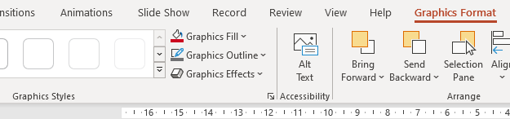

Change icon colour
Approach
Notes
Select icon
In the tab «Graphics Format» under «Graphics Styles», use «Graphics Fill» to change the colour
For some icons, the colour can be changed by using «Graphics Outline» instead of «Graphics Fill».
The colour cannot be changed if an icon is inserted as a picture. In this case, after selecting the icon, the tab «Picture Format» appears instead of «Graphics Format».
Best vector file format for icons: *.svg

Slide 40



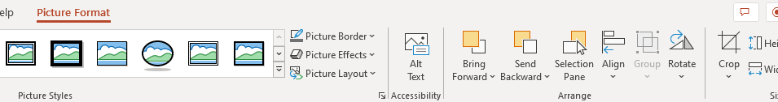


Insert image into placeholder
Insert image from external source
Click on the image icon, select image from Sharepoint or other source
The bbv image library is here locally located: C:\Users\Public\bbv_templates\Marketing\PPT-Bibliotheken\Bilder-Bibliothek
Or: copy image from external source with Ctrl+C, select the placeholder, then paste with Ctrl+V
Adjust
Select the image
Click in the tab «Picture Format» on «Crop»
Adjust the image composition by moving the image
Resize the image by clicking and dragging the outer circles.
Click again on «Crop» to finish the adjustments

Slide 41


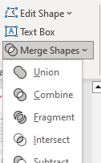

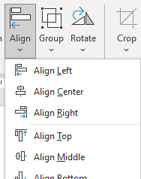

Insert image into mock-up screen (mobile/laptop)
Mock-up
Paste image
Copy image from external source with Ctrl+C and paste with Ctrl+V
Image mask
Adjust size & determine image area:
Place image behind image mask
Adjust image size and determine image area
Image mask
Crop image to image mask
Select image
Select image mask
Click in the tab «Shape Format / Merge Shapes» on «Intersect»
Combine image with mock-up
Place image behind mock-up
Activate image and mock-up and align both horizontally (Align Center) and vertically (Align Middle)
Group image and mock-up with Ctrl+G

Slide 42
bbv template EN
Style guide

Slide 43
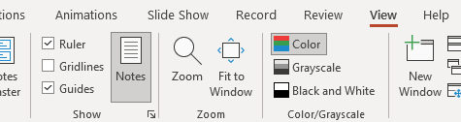

Working area, guides & ruler
Working area
Depending on the slide, a single-column layout, a 2-column or 3-column layout is used.
Display the ruler and guides in the «View» tab.

Slide 44
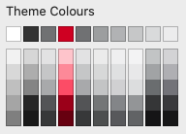
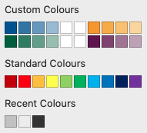
bbv colour theme
Always OK!
Never, please!
Default text colours
Main accent
Colours for diagrams, charts, graphs etc.
Use selectively and sparingly
Never, please!
Colours for diagrams, charts, graphs etc.
Colours for diagrams, charts, graphs etc.

